Slide 1
Project Requirements
GP Application
Vina Panduwinata
Mat. 492243

Slide 2
Project Objectives
As a mediator for connecting the patient and the GP.
Supporting the sustainable environment with paperless application.
1
3
2
4
Helping patient to visit the GP online via platform and get a treatment faster
On the next phase of development can be used to detect fraud, monitoring and control the GP services.

Slide 3
Project Scope (I)
The scope related to GP application which is can be accessed by GP via personal PC, connected to extranet, served by secured peer to peer connection and the transmission between patient’s data and GP’s data made by API json format or xml data format through REST API with Oauth 2.0 authentication token.

Slide 4
Project Scope (II)
The business process start from patient’s action by booking the schedule to visit GP, but GP also as a human have their own situation and urgent matter, GP can choose to block the date and time where the GP is not available, in GP application, there will be a feature to block the option and reason for absent.

Slide 5
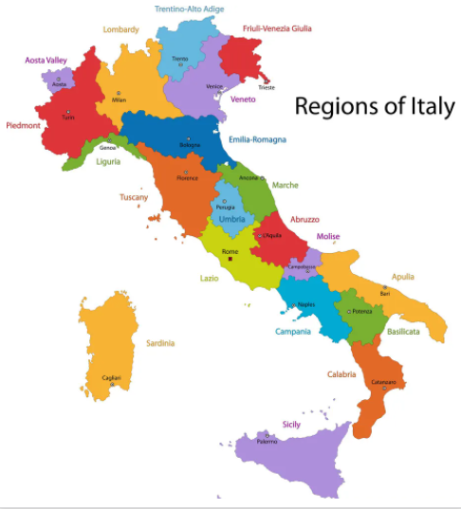
Target Geography
Short term deployment | Long term deployment
Only for each of the region in italy, starting from Lombardia region. | Connecting all of the region in Italy, so the citizen of the other region of Italy can access a good GP services by reference in a different region.

Slide 6
Business Process (I)
GP’s Application
Reservation/Booking
Visit
Diagnosis
Medical Prescription
Further Action : control
Online meeting
Offline meeting
Dosage
Procedure

Slide 7
Business Process (II)
Reservation
Visitation
Diagnosis
Patient make a reservation by login to the mobile application
Doctor can input a diagnosis of patient health by making an examination or by the application which is provide some health sensor to detect patient’s temperature or blood/hearth pulses
Patient can visit the doctor or from their home (in case of any urgent matter)
Register to the app/ login
Take a picture of NHC
If valid then patient can choose the day and time to reserve a visit
Patient can choose up to 1 visit per day and change/cancel the visit min day-3
Patient can choose visitation mode (online, offline)
Patient should agree with T&C
The GP can see the patient’s reservation and if the patient visit the GP (online or onsite), the GP just need to give an input by clicking the schedule that change the status of visitation (no show, online, offline)
If in the online mode, the patient app send the real time data to GP app and GP can do further examination with the patient, otherwise GP input the diagnosis

Slide 8
Business Process (III)
Medical Prescription
Suggestion
After the examination, GP can input the medical prescription to the bracket of the patient also patient will have lab examination afterwards.
Both GP and patient can make an arrangement to have a visitation in the mean time
GP offer another examination in a lab
GP input the list of medical prescription
The patient can buy the medicine from the pharmacy or in the hospital
GP can offer patient to book another day to visit

Slide 9
GP Application
Reservation
Visitation
Diagnosis
Medicine
Suggestion
Queries , search by ; patient name medicine date of each treatment ( reservation, visit, etc )
Queries
Auth & Validation
Report &
Analytic
Monitoring & Control

Slide 10

Project Cost
3 Developer (database, front-end, back end)
UI/UX designer, QA tester, Product owner, scrum master
Marketing expense
Infrastructure : setup peer to peer connection, deployment to server (cloud)*
Testing and maintenance system
End user training
System security implementation : analytic, support
will be explained in detail in deployment diagram

Slide 11
Project Timeline
Product backlog
Information within project scope
Delegate task
Define MVP
Project retrospective
Design for UI
Flow for UX
Choose technical platform
20 days
Scrum meeting (daily)
Project review
Doing coding in project
Check the UI/UX flow
1 day
Construction and iteration
Release code to development
Planning for project change
Doing code for the project
Testing and debugging
3 months
Release code to production
Planning for project change
UAT
Doing code for the project
Testing and debugging
1 month

Slide 12
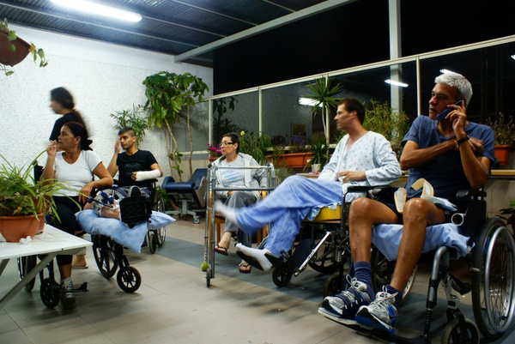


Organization (I)
Patient :
- Make a reservation in easy way, save time and paperless
- Get available schedule of GP
- Manage the reservation (update and cancellation)
- Securely accesses medical history
- Make an offline or online visit
Value proposition
Provide value for each stakeholder
Doctor :
- Block specific date for urgent matter
- Manage the reservation (update and cancellation)
- Securely accesses medical history
- Reach out patient out of his location
- Speed up service for next suggestion visit
- Get help from AI technology for accurate diagnosis
Lab :
- Securely accesses medical history
- Speed up service for patient from a reference of the GP
Specialist :
- Securely accesses medical history
- Speed up service for patient from a reference of the GP

Slide 13
Organization (II)
Change Analysis
DRIVERS | PATIENT | DOCTOR | LAB | SPECIALIST
Strategy | None | None | None | None
Structure | Unchanged | Unchanged | Unchanged | Unchanged
Process | Online process | New process | Collaboration | New process
Reward | Time and money | Patient reward | Good Reference | Good Reference
People (skill) | Practicing by doing | Moderate training | Moderate training | Moderate training

Slide 14

Change analysis comment
Task deliverables :
Changes of the process flow
Establish an online process for visit
Introduce AI helper to GP
Provide training for GP and stakeholder
Provide a guideline or user manual for patient

Slide 15
Technologies (Elements)
Operational model to be adopted : cloud (public and private)
01
1. Mobile technologies (camera, speaker)
2. IOT
3. Sensor
4. QR scanner
5. Printer, PC/laptop
Hardware
02
1. Database
2. Business Intelligent
3. AI technologies
Middleware / Software

Slide 16

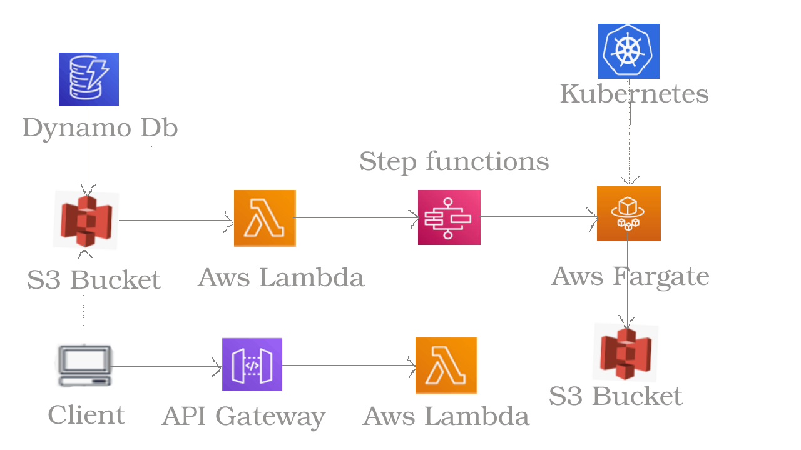
Technologies (Architecture)
Deployment diagram

Slide 17

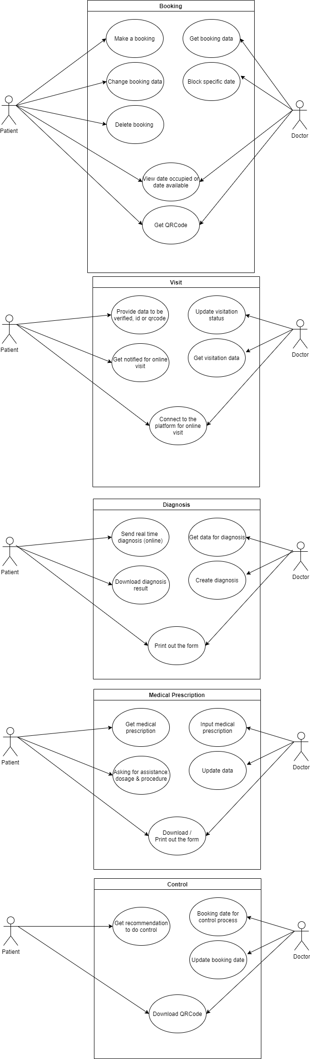
Technologies (Architecture)
Use case diagram

Slide 18
Technologies (Architecture)

